Slide 1
Introducing …
Distributed Systems

Slide 2
Definition of a Distributed System (1)
A distributed system is:
“A collection of independent computers that appears to its users as a single coherent system.”

Slide 3
Goals of Distributed Systems
Easily Connect Users/Resources
Exhibit Transparency
Support Openness
Be Scalable
  in size
  geographically
  administratively
Looking at these goals helps use answer the question: “Is building a distributed system worth the effort?”

Slide 4
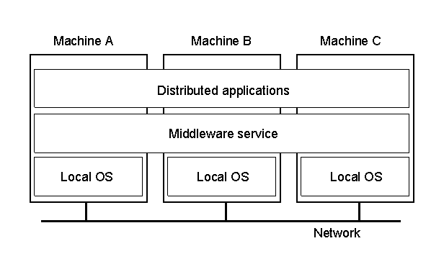
Definition of a Distributed System (2)
1.1
A distributed system organized as middleware.
Note that the middleware layer extends over multiple machines.

Slide 5
Transparency in a Distributed System
Transparency | Description
Access | Hide differences in data representation and how a resource is accessed
Location | Hide where a resource is located
Migration | Hide that a resource may move to another location
Relocation | Hide that a resource may be moved to another location while in use
Replication | Hide that a resource may be shared by several competitive users
Concurrency | Hide that a resource may be shared by several competitive users
Failure | Hide the failure and recovery of a resource
Persistence | Hide whether a (software) resource is in memory or on disk
Different forms of transparency in a distributed system.

Slide 6
Scalability Problems
Concept | Example
Centralized services | A single server for all users
Centralized data | A single on-line telephone book
Centralized algorithms | Doing routing based on complete information
Examples of scalability limitations.

Slide 7
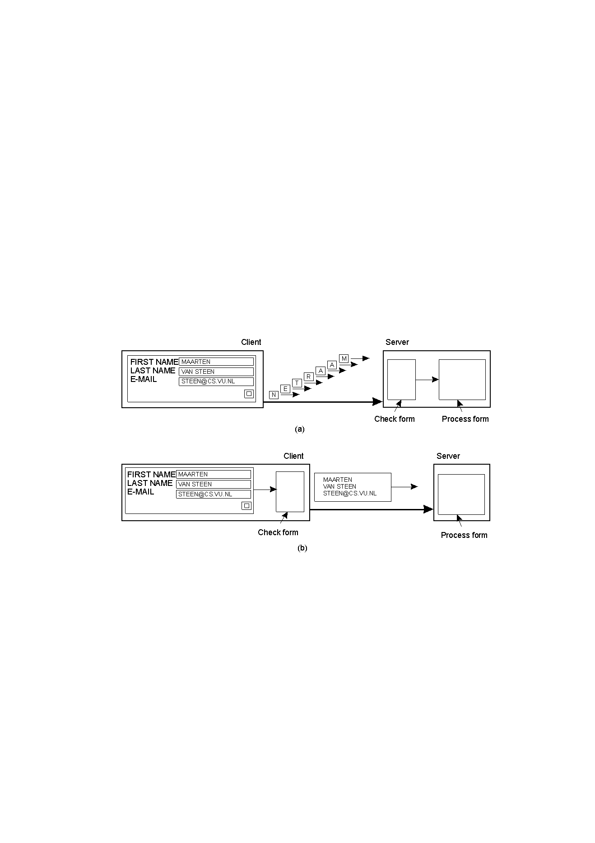
Scaling Techniques (1)
1.4
The difference between letting:
a server or
a client check forms as they are being filled

Slide 8
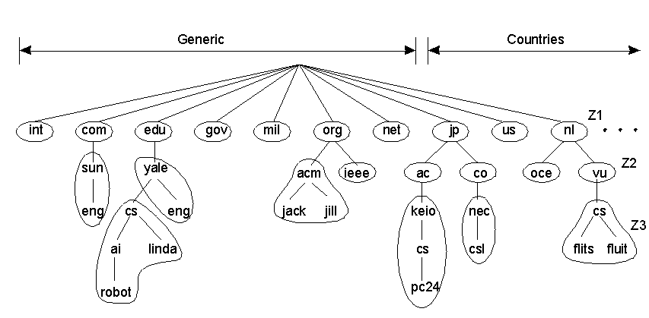
Scaling Techniques (2)
1.5
An example of dividing the DNS name space into zones.

Slide 9
Modeling Distributed Systems
When building distributed applications, system builders have often looked to the non-distributed systems world for models to follow (… inspiration?)
Consequently, distributed systems tend to exhibit certain characteristics that are already familiar to us
This applies equally to hardware concepts as it does to software concepts

Slide 10
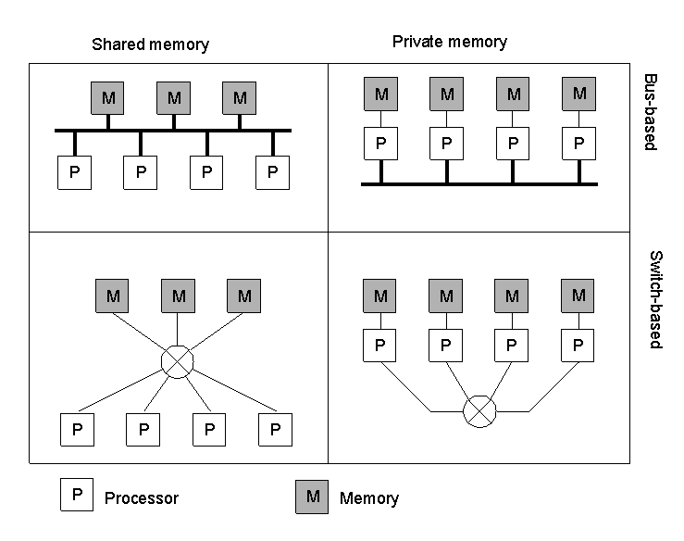
Modeling Hardware Concepts
1.6
Different basic organizations and memories in distributed systems

Slide 11
Modeling Software Concepts
System | Description | Main Goal
DOS | Tightly-coupled operating system for multi-processors and homogeneous multicomputers | Hide and manage hardware resources
NOS | Loosely-coupled operating system for heterogeneous multicomputers (LAN and WAN) | Offer local services to remote clients
Middleware | Additional layer atop of NOS implementing general-purpose services | Provide distribution transparency
An overview of
DOS (Distributed Operating Systems)
NOS (Network Operating Systems)
Middleware

Slide 12
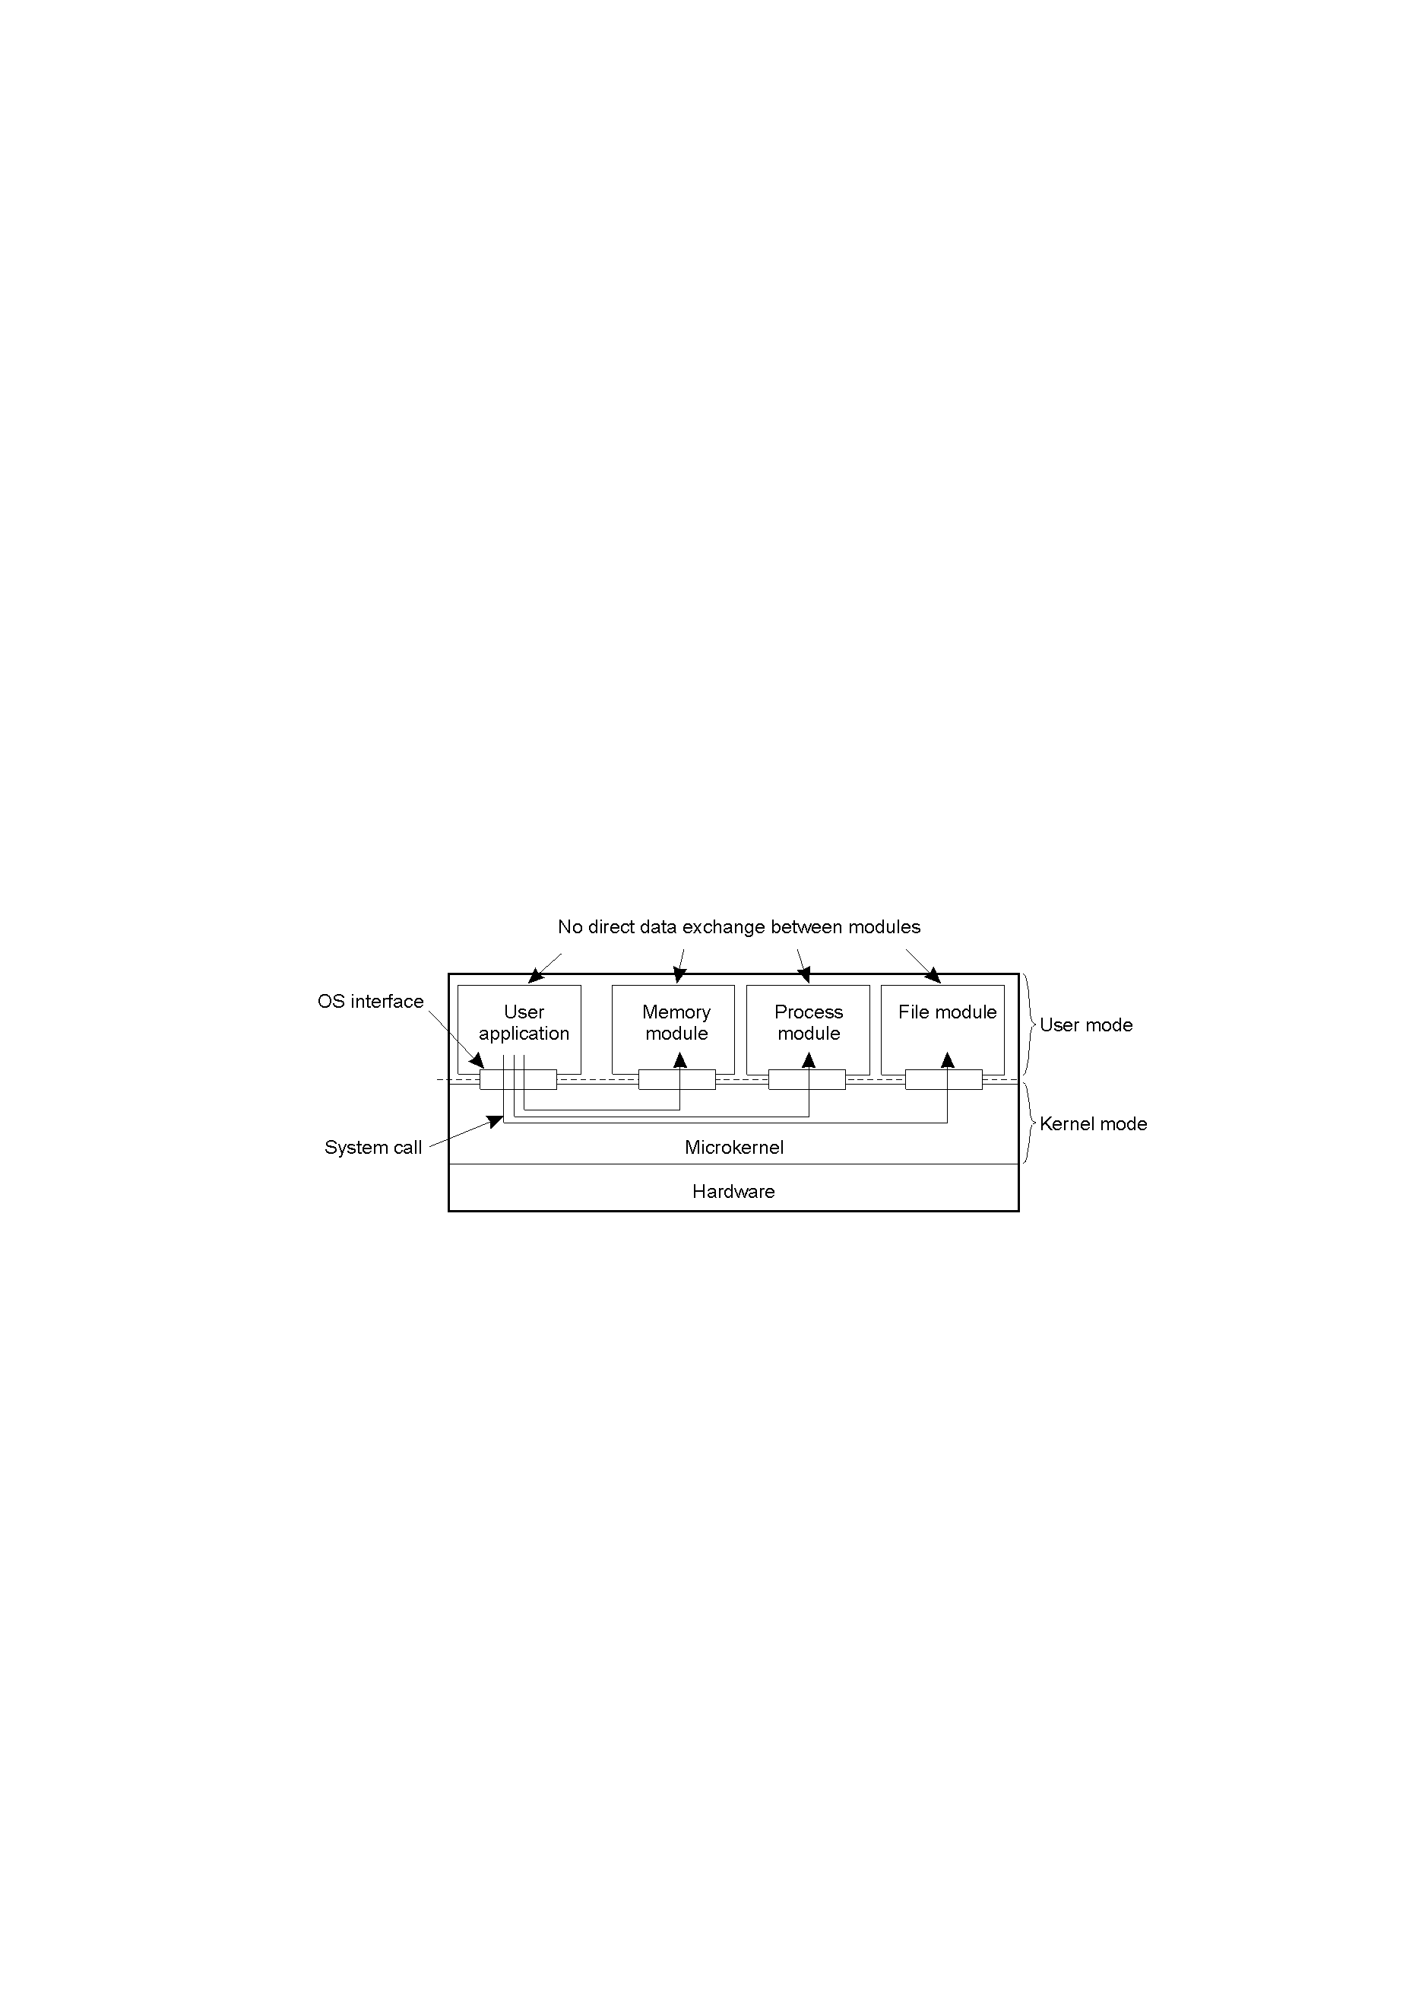
Uniprocessor Operating Systems
1.11
Separating applications from operating system code through
a “microkernel” – can provide a good base upon which to build a distributed operating system (DOS).

Slide 13
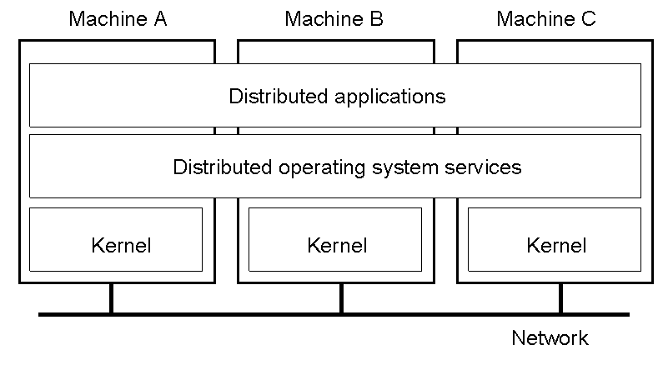
Multicomputer Operating Systems (1)
1.14
General structure of a (DOS) multicomputer operating system – all the systems are of the same type: homogeneous

Slide 14
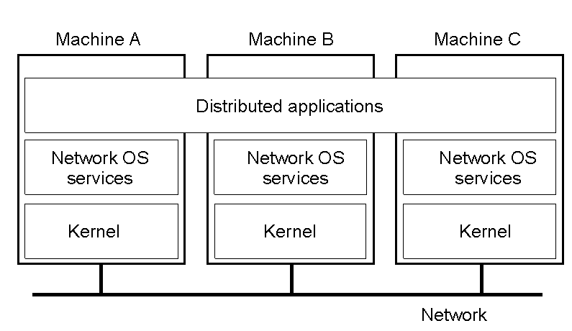
Network Operating System (1)
1-19
General structure of a network operating system – all the systems are of different types: heterogeneous

Slide 15
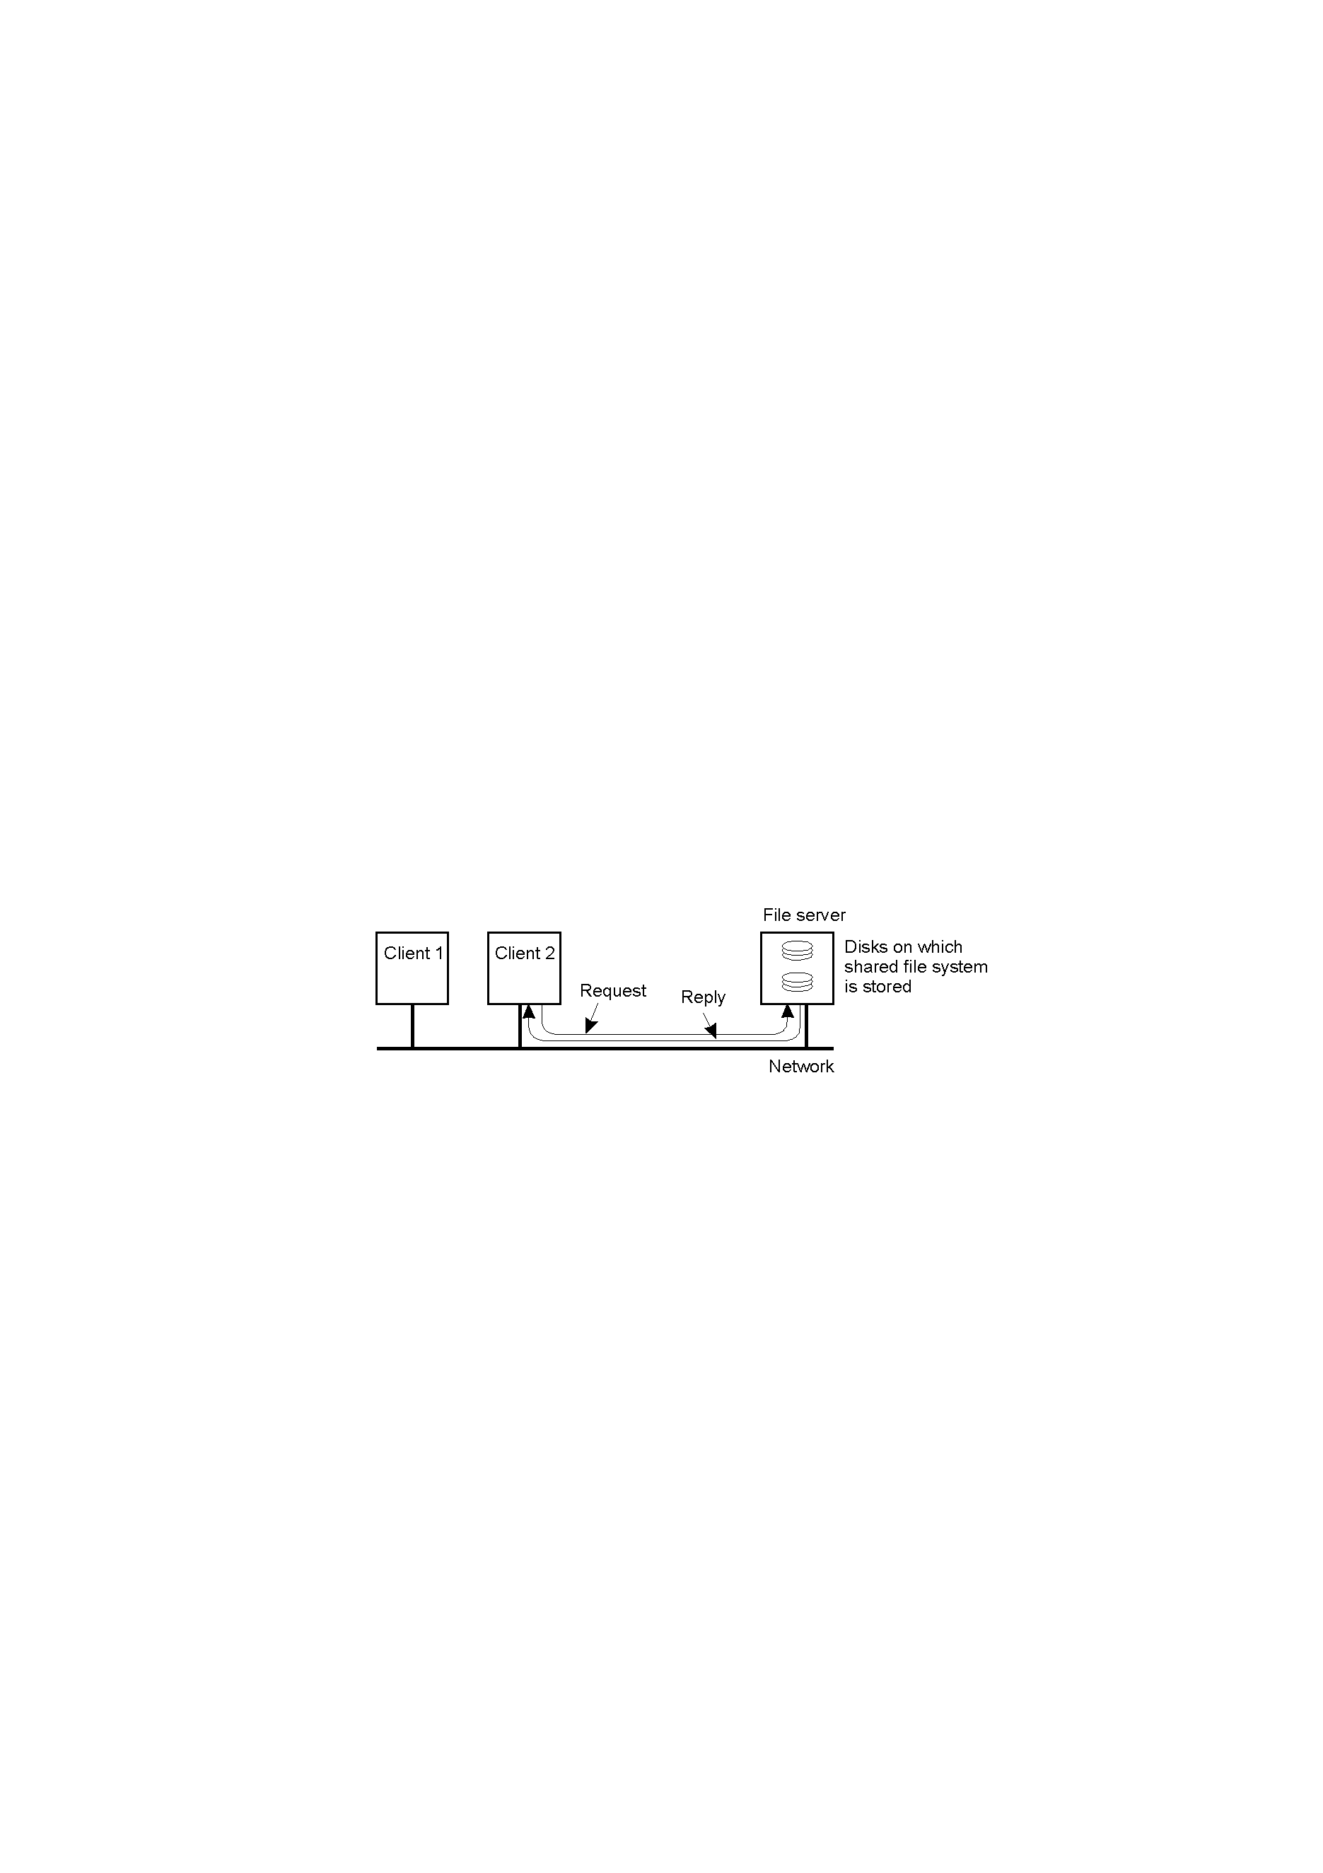
Network Operating System (2)
1-20
Two clients and a server in a network operating system – relatively primitive set of services provided.

Slide 16
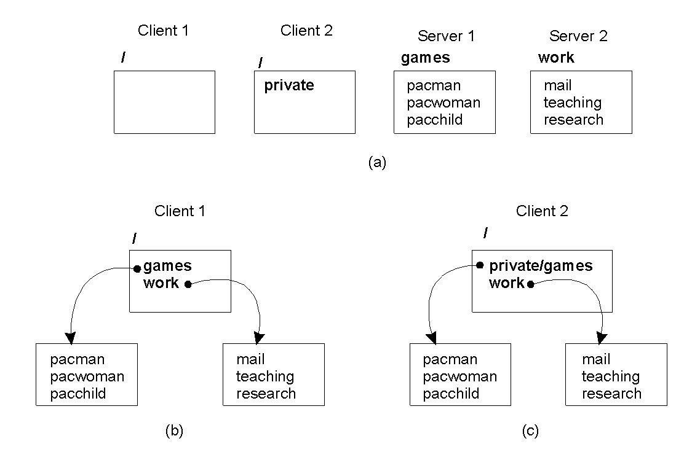
Network Operating System (3)
1.21
Different clients may mount the servers in different places – difficult to maintain a consistent “view” of the system.

Slide 17
The Best of Both Worlds?
DOS: too inflexible (all systems of the same type)
NOS: too primitive (lowest common demoninator – too much diversity)
“Middleware” – best possible compromise?
Middleware = NOS + additional software layer

Slide 18

Positioning Middleware
1-22
General structure of a distributed system as middleware.

Slide 19

Middleware and Openness
1.23
In an open middleware-based distributed system, the protocols used by each middleware layer should be the same, as well as the interfaces they offer to applications. This is a much higher level of abstraction than (for instance) the NOS Socket API.

Slide 20
Middleware Models/Paradigms
Distributed File Systems
The Remote Procedure Call (RPC)
Distributed Objects
Distributed Documents
[All of which we return to in detail later in this course … ]

Slide 21
Comparing DOS/NOS/Middleware
Item | Distributed OS |  | Network OS | Middleware-based OS
 | Multiproc. | Multicomp.
Degree of transparency | Very High | High | Low | High
Same OS on all nodes | Yes | Yes | No | No
Number of copies of OS | 1 | N | N | N
Basis for communication | Shared memory | Messages | Files | Model specific
Resource management | Global, central | Global, distributed | Per node | Per node
Scalability | No | Moderately | Yes | Varies
Openness | Closed | Closed | Open | Open
A comparison between multiprocessor operating systems, multicomputer operating systems, network operating systems, and middleware based distributed systems.

Slide 22
The Classic DS Model
How are “processes” organised within a Distributed System?
General agreement/concensus:
“Client/Server” Model
Multi-tiering:
User Interface Level, Processing Level, Data Level.

Slide 23
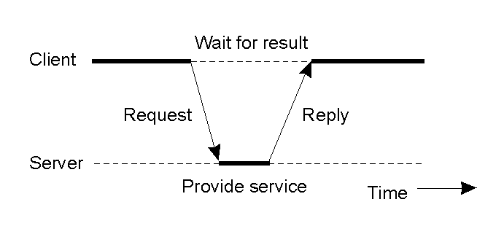
Clients and Servers
1.25
General interaction between a client and a server.

Slide 24
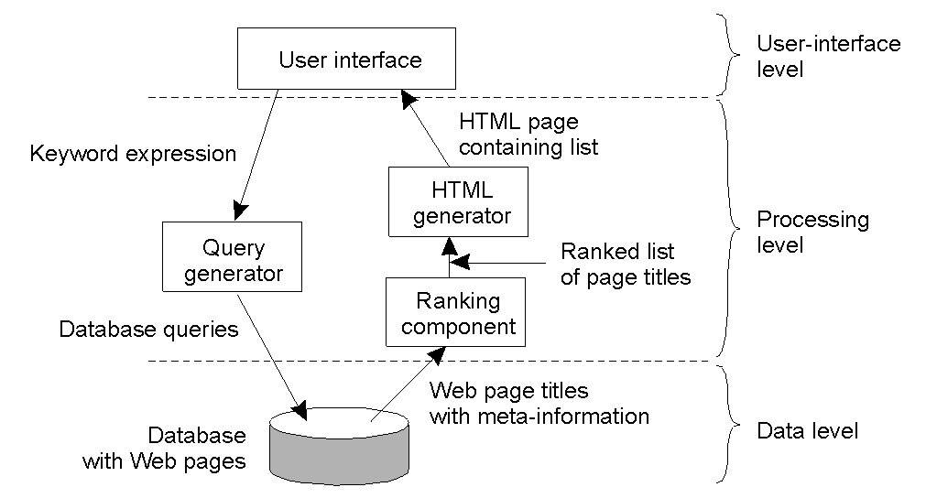
Processing Level – Multi-layered
1-28
The general organization of an Internet search engine into three different layers – often referred to as “tiers”.

Slide 25
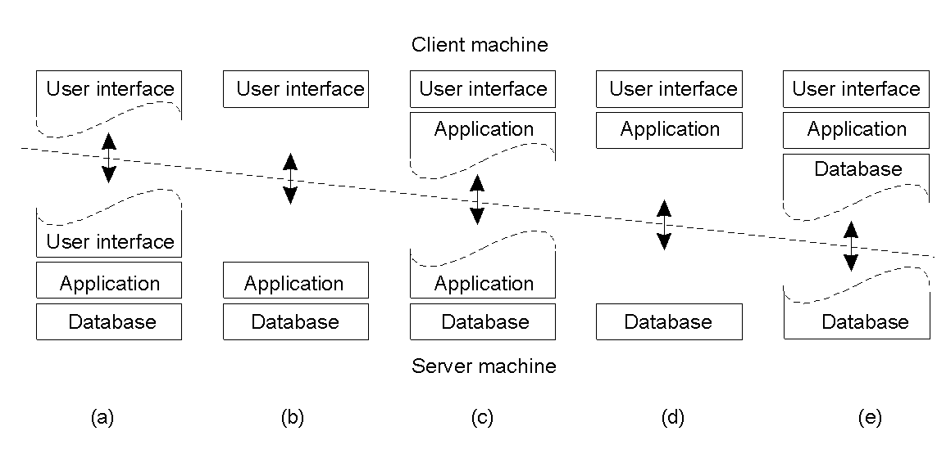
Multitiered Architectures (1)
1-29
Alternative client-server organizations (a) – (e).

Slide 26
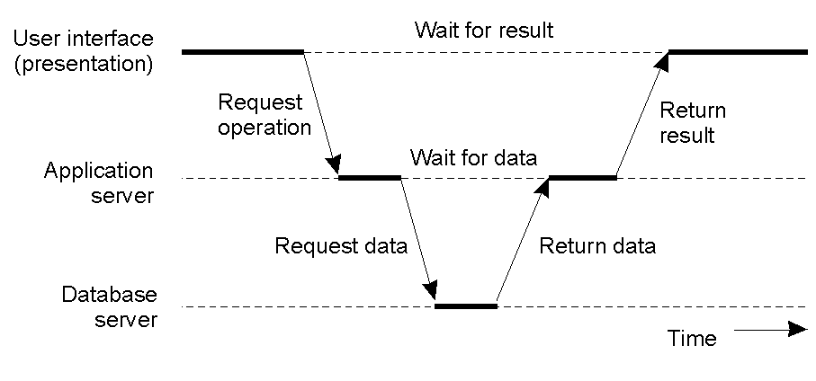
Multitiered Architectures (2)
1-30
An example of a server acting as a client – this is a very common vertical distribution model for distributed systems.

Slide 27
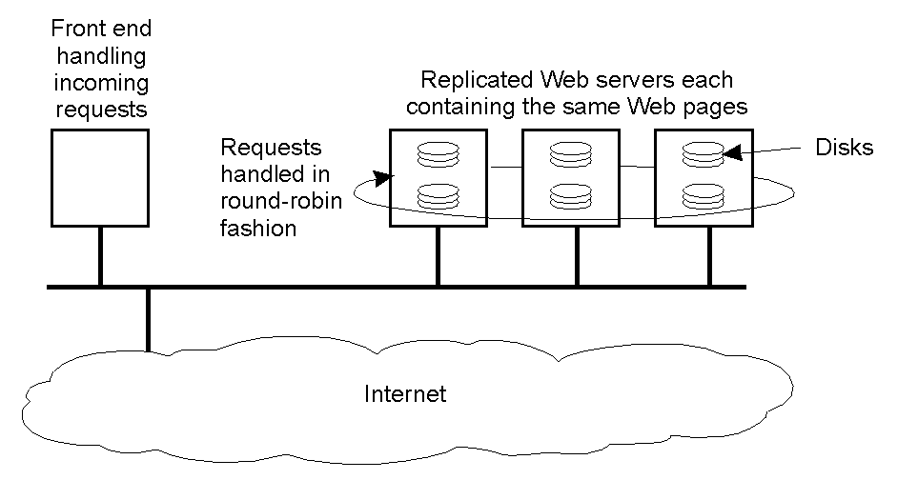
Example Modern Architecture
1-31
An example of horizontal distribution of a Web service (often also referred to as “clustering”).

Slide 28
Summary (Introduction)
Distributed Systems … autonomous computers working together to give the appearance of a single, coherent system.
They are transparent, scalable and open.
Unfortunately, they also tend to be complex.
Types of DS: DOS, NOS, Middleware.
Processes within DSs conform to the “client/server model”.
Architectures included vertical and horizontal arrangements, often into many levels/tiers.

